Slide 1
PROCESSES

Slide 2
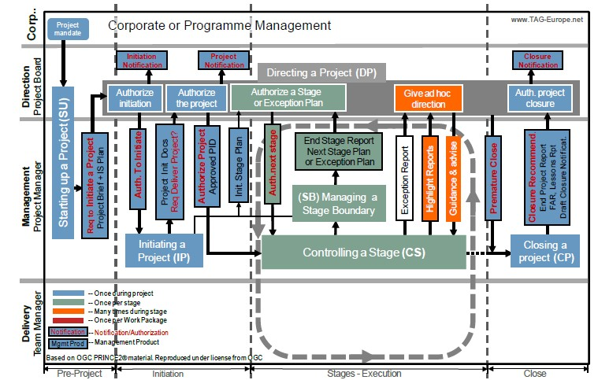

Slide 3
Purpose of Starting up a Project
Starting Up a Proje^{A}c^{ut}t^{hor}
- Pankaj
The purpose of this process is to answer the question, “Do we have a worthwhile and viable project?” The project mandate is usually the only document that exists when this process starts, and this is not enough information for the Project Board to make the decision to start the Initiation Stage.
The purpose of this process is to provide the Project Board with the necessary information to judge if the project is worthwhile. They use the Project Brief, which will contain information on the Business Case. Another important purpose of the Starting Up a Project process is to prevent poor projects from starting up.
This process should be brief; perhaps that’s where we get the name Project Brief. In fact, the aim is to do the minimum necessary just to see if the project is worthwhile doing the Initiation stage.

Slide 4
Objectives of Starting up a Project
Starting Up a Proje^{A}c^{ut}t^{hor}
- Pankaj
The objectives of the Starting Up a Project process are to prepare and make sure that the following is done during and by the end of this process:
There is a Business Case or a business reason and this should be documented in the outline Business Case. The Business Case document will not be completed until the Initiation Stage.
Look at the project approach, which examines the best way to go about doing this project and obtaining advice from other projects in the form of lessons learned, specialists or even outside knowledge.
Choose the people who will do the work to initialize the project, and other roles in the project team.
Create the Project Brief, which provides information on the scope of the project and most of the information collected to date in this process.
Create a detailed Stage Plan to plan the work to be done in the Initiation Stage.
So as you can see, the Starting Up a Project process objectives are to provide the
Project Board with certain information and to prepare the Initiation Stage.

Slide 5
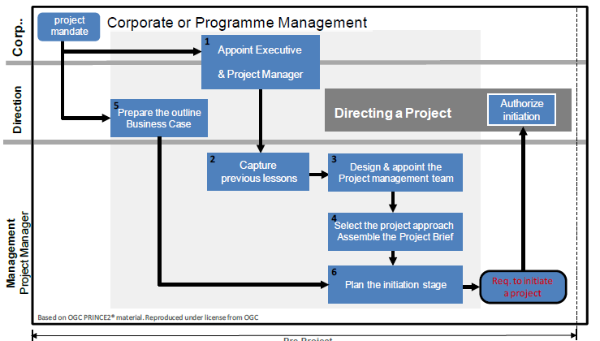
Starting up a Project
Starting Up a Proje^{A}c^{ut}t^{hor}
- Pankaj

Slide 6
Starting up a Project
Starting Up a Proje^{A}c^{ut}t^{hor}
- Pankaj
The ’starting up a project’ process ensures that sufficient planning is in place before initiating a project. The process is triggered after the mandate is received from the corporate program management. The primary output of this process is project brief.
The key activities in this process are
Appoint the Executive and Project Manager
Prepare the Outline Business Case & Project Product Description
Capture Previous Lessons
Design and Appoint Project Management Team
Select the project approach and assemble the Project Brief
Plan the initiation stage
Create Project Product Description
Triggers the directing the project process with request to initiate the project

Slide 7
Starting up a Project
Starting Up a Proje^{A}c^{ut}t^{hor}
- Pankaj
The Executive is responsible for Appointing the Project Manager, the Project Management Team and creating the outline Business Case.
The Project Manager is responsible for Roles descriptions, capturing previous lessons, project approach, assembling the Project Brief, creating and updating the Daily Log, and creating the Initiation Stage Plan.

Slide 8
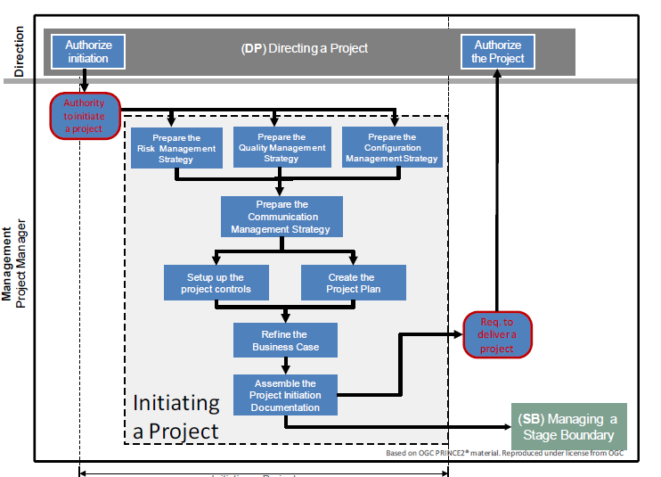

Slide 9
Initiating a Project
Initiating a Project^{Author}
- Pankaj
The purpose of this Process is to establish solid foundations for the project, enabling the organization to understand the work that needs to be done to deliver the project’s product before there is a commitment to significant spending.
This understanding is needed before deciding to continue with the project. Like any project there are a number of important items to discover and so there are a number of questions to ask about the project:
What are the reasons for doing the project and the Benefits and Risks?
Scope: What is to be done and what will not be included?
When can the products be delivered?
How to ensure that quality will be achieved?
How risks, issues and changes will be identified and followed up?
How project progress will be monitored, who needs to be informed and how often do
they need to be informed?
And lastly how PRINCE2 will be tailored to suit the project?

Slide 10
Objectives of Initiating a Project
Initiating a Project^{Author}
- Pankaj
The key objective of this process is to ensure that there is a common understanding of:
The reason for doing the project, the benefits expected and the associated Risks,
The Scope of what is to be done and the products to be delivered
How and when the project’s products will be delivered and at what cost
•,Who is to be involved in the project decision making
How the quality required will be achieved
How baselines will be established and controlled
How risks, issues and changes will be identified assessed and controlled
How progress will be monitored and controlled
Who needs information, in what format and at what time

Slide 11
Initiating a Project
Initiating a Project^{Author}
- Pankaj
Following are the Activities performed in Initiating a Project Process
Prepare Risk Management Strategy
Prepare Configuration Management Strategy
Prepare the Quality Management Strategy (QMS)
Prepare the Communication Management Strategy
Set up the Project Controls
Create the Project Plan
Refine the Business Case
Assemble the Project Initiation Document (PID)

Slide 12
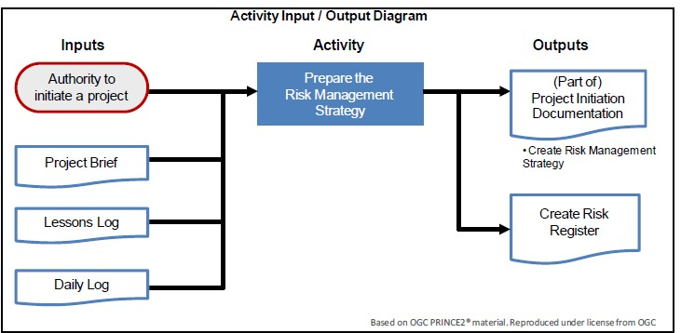
Initiating a Project
Initiating a Project^{Author}
- Pankaj
Prepare the Risk Management Strategy

Slide 13
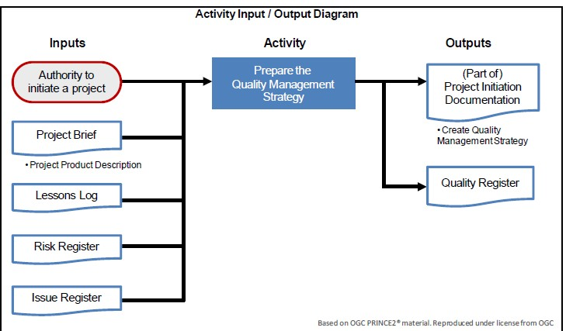
Initiating a Project
Initiating a Project^{Author}
- Pankaj
Prepare the Quality Management Strategy

Slide 14
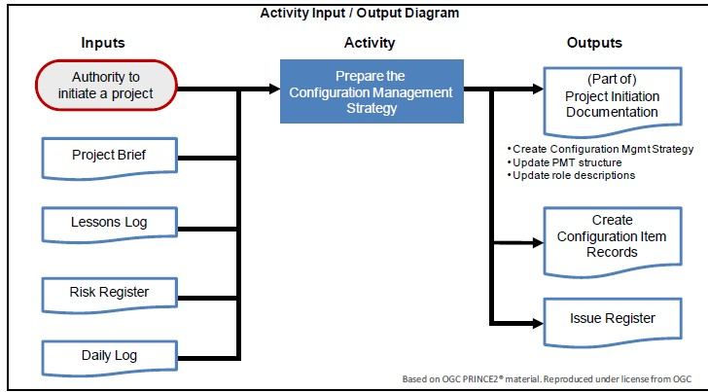
Initiating a Project
Initiating a Project^{Author}
- Pankaj
Prepare the Configuration Management Strategy

Slide 15
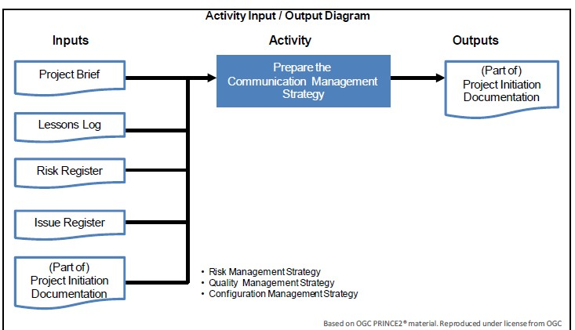
Initiating a Project
Initiating a Project^{Author}
- Pankaj
Prepare the Communication Management Strategy

Slide 16
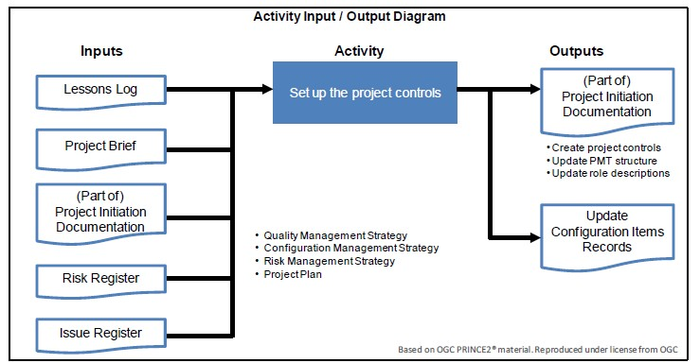
Initiating a Project
Initiating a Project^{Author}
- Pankaj
Setting up the project controls

Slide 17
Initiating a Project
Initiating a Project^{Author}
- Pankaj
The Project Manager assembles the Project Initiation Documentation and
includes the following information and documents:
Project Brief
Project Management Team Structure and Roles Descriptions
Business Case
Four Management Strategy documents: Quality, Configuration Management, Risk and Communications
Project Plan
Project Approach, Project Controls and how PRINCE2 was tailored to suit the project
Project Assurance will check that it contains the necessary information and
can be put forward to the Project Board
The last task done by the Project Manager is the request to deliver a project. This request is made to the Project Board and they will decide if the project can continue or stop. This request can be formal or informal and depends on the culture of the company and size of the project.

